Slide 1


Heart Disease Monitoring and Analysis - Real-Time and Batch Data Processing in AWS Cloud
Henry Oluoma
Big Data Developer

Slide 2
TABLE OF CONTENTS
01
Introduction
02
Problem Statement
03
Project Objectives
04
End-to-End Data Pipeline Diagram
05
Batch Data Processing
06
AWS GLUE ETL, Storage and Data Cataloguing
07
Data Warehousing & Dimensional Modelling in REDSHIFT
08
Real-Time Data Processing
09
Analysis & Visualisations
10
Conclusion
2024

Slide 3
INTRODUCTION
Overview of the Project
In this project, we aim to create a comprehensive system for monitoring and analysing heart disease through real-time and batch data processing. As a Big Data Developer, my focus will be on optimizing data ingestion, processing, and management to enhance our understanding of heart disease risk factors and improve patient outcomes.
Importance of Monitoring Heart Diseases
Effective monitoring of heart disease is essential for early detection and timely intervention, which can significantly lower morbidity and mortality rates. By utilizing advanced data analytics, we can provide healthcare professionals with actionable insights to better manage heart health.

Slide 4

PROBLEM STATEMENT
Critical Challenges in Heart Disease Monitoring
Effective monitoring of heart disease is hindered by several key challenges:
Outdated Data: Many existing systems rely on historical data that may not accurately reflect real-time patient conditions, leading to delayed interventions.
Limited Integration: Current solutions often lack integration across diverse data sources, such as lifestyle choices and demographic factors, which impedes comprehensive risk assessment.
Generic Insights: Existing models frequently provide generalized recommendations that do not cater to individual patient profiles, limiting their effectiveness in personalized care.
To address these issues, we propose a dual approach utilising both real-time and batch data processing.

Slide 5


Batch Data Processing:
Analyse historical patient data to identify patterns and risk factors associated with heart disease.
The batch dataset will include key variables such as heart disease status, bmi, smoking habits, physical health metrics, and demographic information.
This comprehensive analysis will facilitate a deeper understanding of the factors influencing heart disease and support targeted interventions.
Real-Time Data Processing:
Implement a system to collect data from wearables, utilizing kinesis data streams for real-time processing.
Store processed data in dynamodb to ensure quick access and scalability.
Generate alerts via email or text when heart readings exceed predefined thresholds, enabling stakeholders to take immediate action to manage their health.
PROJECT OBJECTIVES
Notes:
Batch Data Processing: "The first objective is to analyze historical data to uncover patterns and risk factors linked to heart disease.
Key Metrics: Metrics such as heart disease status, BMI, smoking habits, physical and mental health scores, and demographics are processed to detect correlations and trends.
Purpose: By understanding long-term patterns, this data can be used to improve preventative measures and guide public health strategies.
2. Real-Time Data Processing: "Our second objective is to create a real-time monitoring system which Focuses on capturing and analysing live data from wearable devices like heart rate monitors.
System Design: The system leverages AWS Kinesis for streaming data and DynamoDB for storage, enabling quick access.
Alerts: Notifications are triggered if certain thresholds (e.g., high heart rate or irregular blood pressure) are exceeded, ensuring healthcare providers can intervene promptly.
Example: Imagine a patient wearing a smartwatch that tracks heart rate and blood pressure. This data is continuously sent to our system through Amazon Kinesis Data Streams. If a critical reading is detected, such as a dangerously high heart rate, our system immediately sends an alert via email or text, allowing for swift action."
"This component ensures that urgent health issues are addressed in real time, potentially preventing severe outcomes."
"Overall, our project bridges the gap between reactive and proactive healthcare by combining historical analysis with real-time data monitoring."

Slide 6
End-to-End Data Pipeline
for
Batch and Real-Time Processing

Slide 8
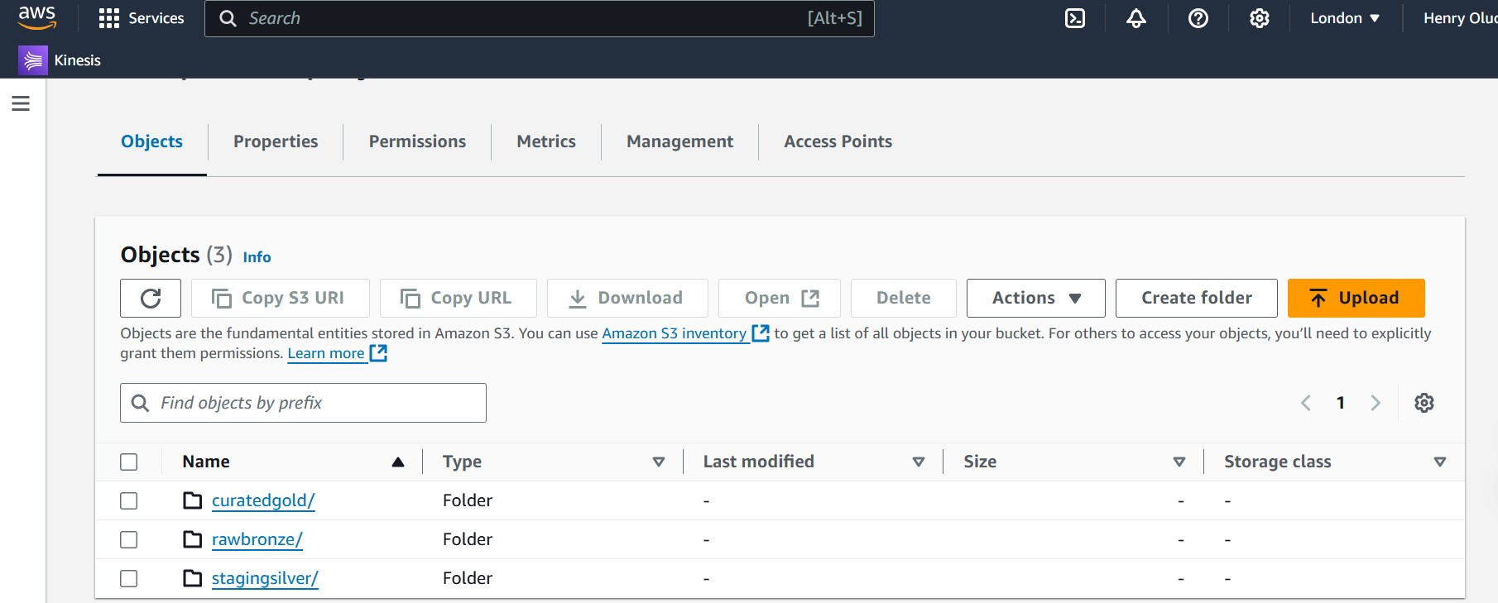
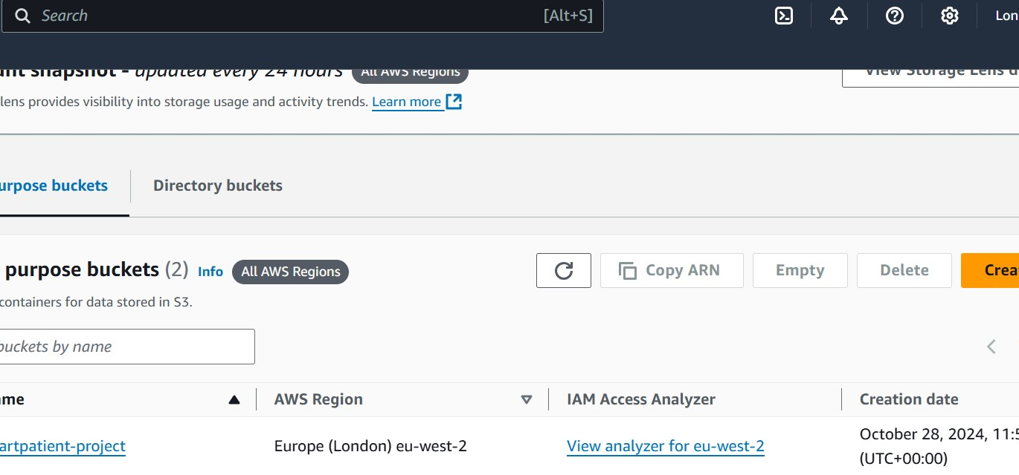
Batch Data Processing
Data Source: Patient data stored in a postgresql database.
Ingestion:
AWS Lambda: Scheduled using eventbridge or cloudwatch to perform batch queries.
Full load: On initial setup, lambda extracts all records and writes them to s3 in csv format.

Slide 9
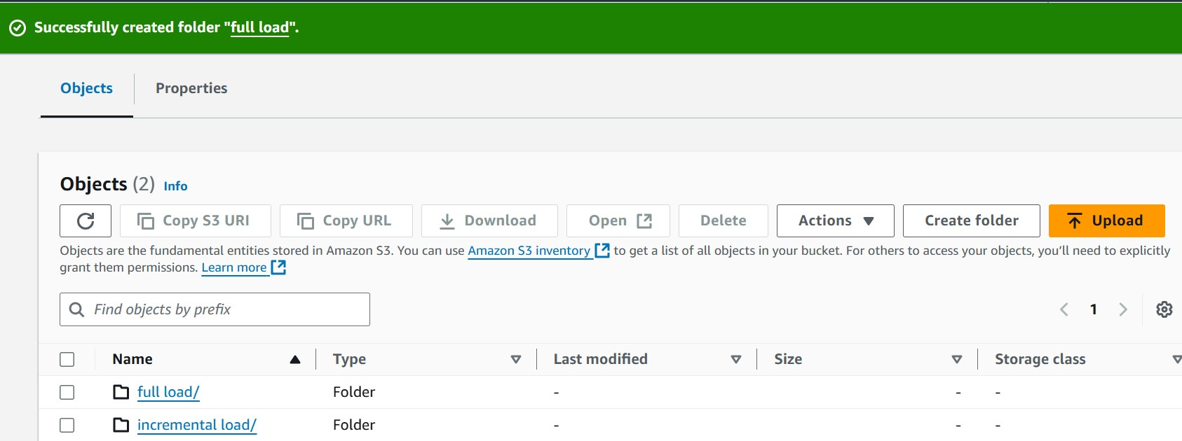
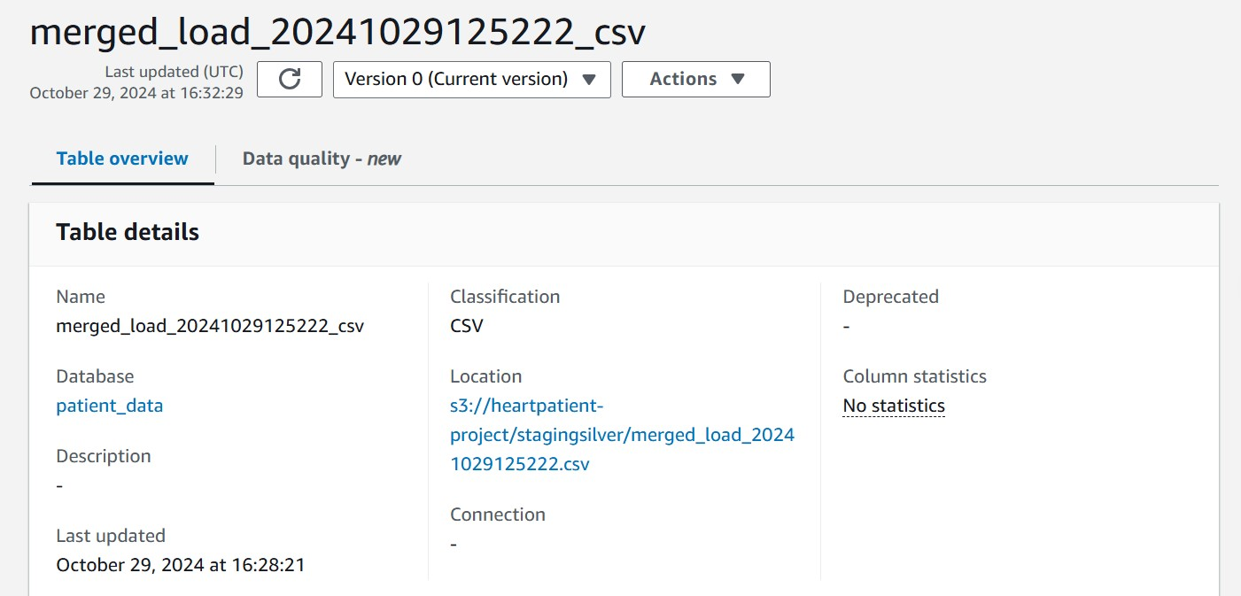
Incremental Load: Subsequent loads fetch only new or updated records using timestamps or primary keys, optimizing data transfers.
New Lambda Function:
Triggered after both Full and Incremental Loads
Responsible for:
Accessing data from both buckets
Merging the data into a single file
Writing the merged file to a Separate Staging Bucket

Slide 10
Storage and Data Cataloguing
Amazon S3 Layers:
Raw Layer: Stores raw batch data in CSV or JSON format.
Staging Layer: Holds processed and transformed data.
Curated Layer: Final data stored in Parquet format, optimized for efficient querying.

Slide 11
AWS Glue Overview
What is AWS Glue?
Definition: AWS Glue is Amazon's fully managed ETL service that simplifies the process of preparing and loading data for analytics.
Key Features:
Automates data discovery and schema inference.
Provides a centralized Data Catalog for easy access and organization of data metadata.
Supports both structured and unstructured data with built-in scalability.
Use Cases: Data integration from multiple sources, data transformation for analytics, and automating data pipelines.
Core Components of AWS Glue
AWS Glue Data Catalog: Stores metadata and schemas of data sources.
DynamicFrame: A data structure that is optimized for data transformations within AWS Glue.
ETL Scripts: Managed and customizable scripts that perform the Extract, Transform, Load operations.

Slide 12
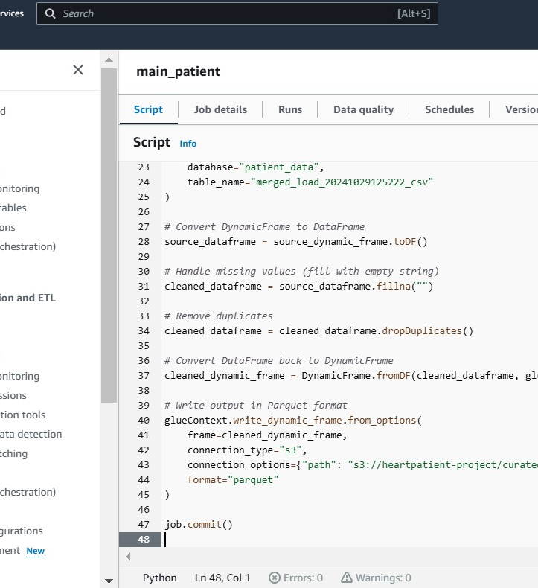
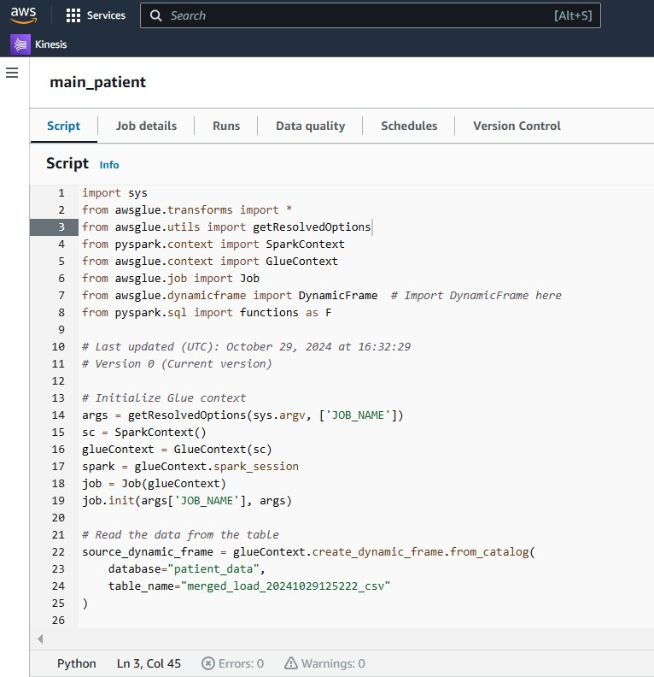

Slide 13
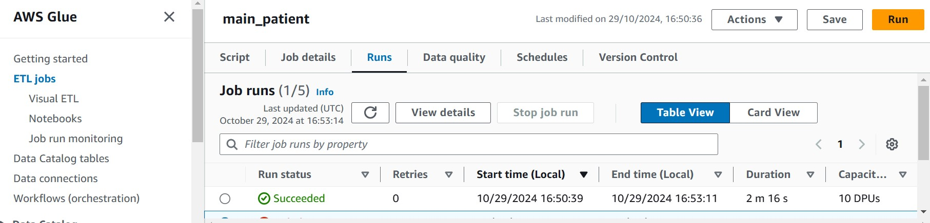
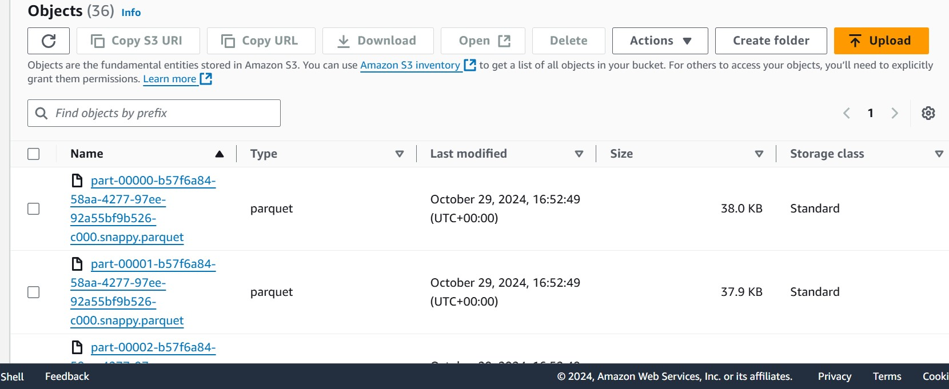

Slide 14
Amazon Athena in Our Heart Disease Monitoring Project
Amazon Athena is a serverless query service that allowed us to efficiently analyse our heart disease monitoring data stored in Amazon S3 using simple SQL. We used Athena to explore and validate the data, ensuring quality and structure for further analysis. With its pay-per-query model, we managed costs while performing ad hoc analysis, like assessing average heart rates and BMI distribution. Athena's integration with AWS Glue simplified our metadata management, and its support for multiple data formats offered flexibility for future optimizations. Overall, Athena provided a quick, scalable, and cost-effective way to derive insights from our data.

Slide 15
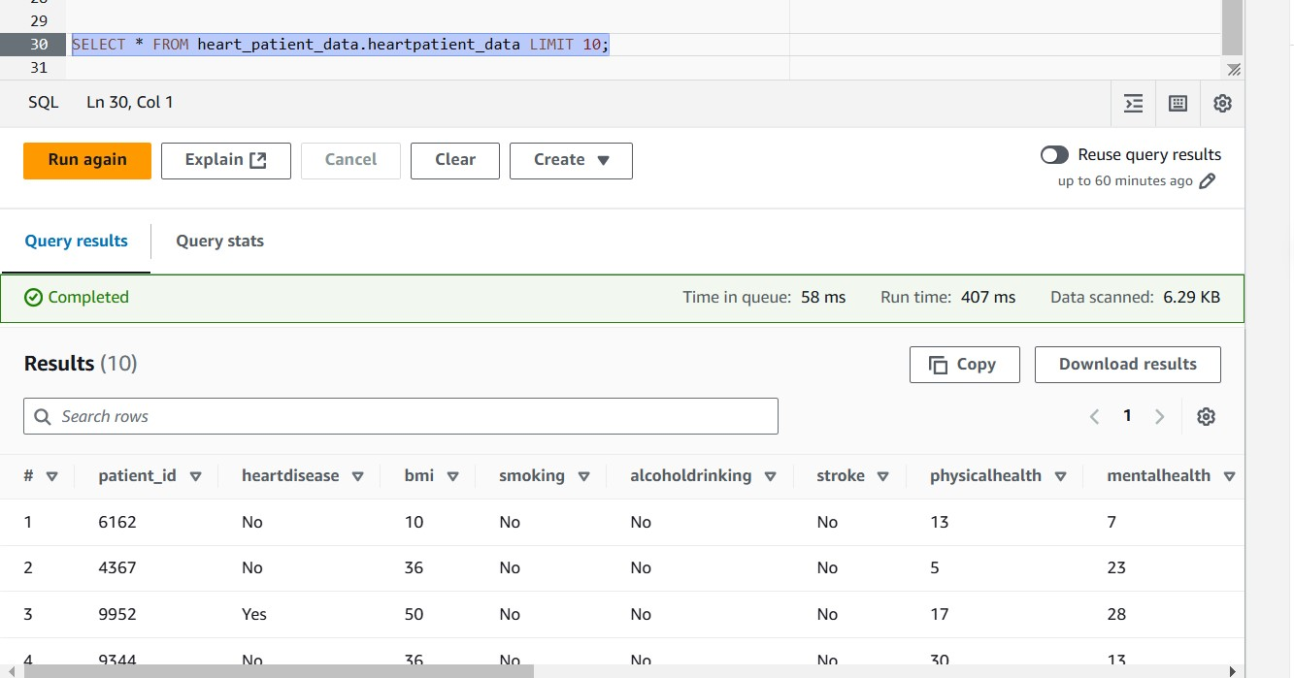
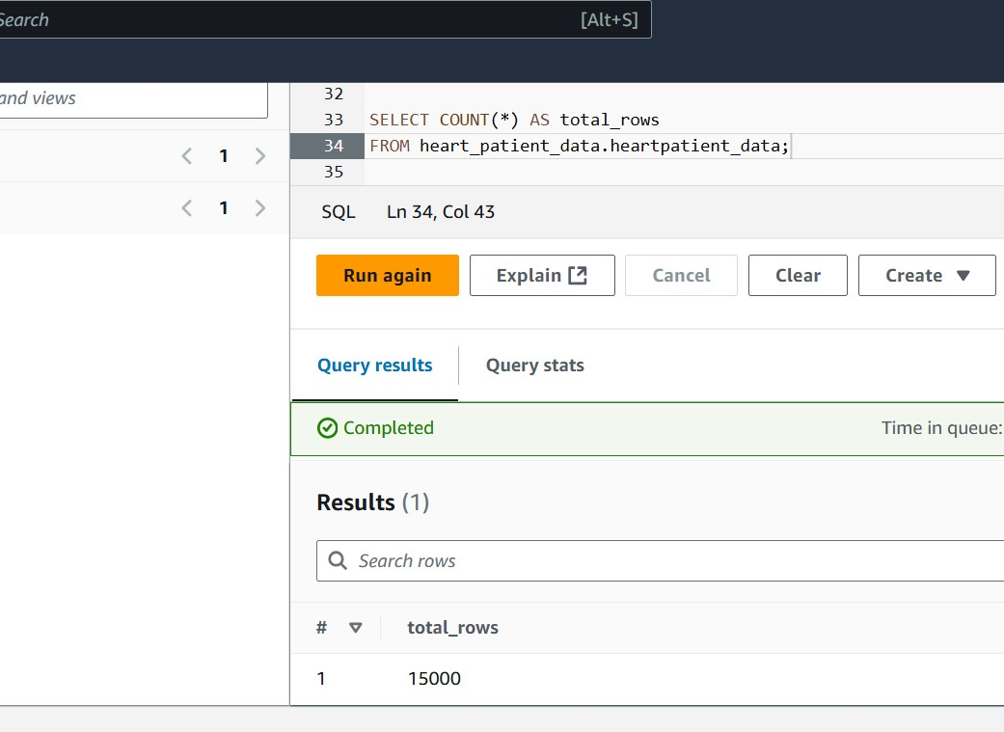

Slide 16
DATAWAREHOUSING in REDshift
Introduction to Amazon Redshift
Amazon Redshift is a fully managed, petabyte-scale data warehouse service in the cloud, part of AWS.
It is designed to handle large-scale data analytics, making data processing fast and efficient.
Redshift allows you to easily run complex queries on structured and semi-structured data and is optimized for high-speed data analysis.
Key features include columnar storage, data compression, and massive parallel processing (MPP) architecture, which help to improve query performance and reduce costs.
Using Redshift, businesses can store historical data and perform complex reporting queries across massive datasets.
Use Case in Our Project: We use Amazon Redshift to store our transformed heart disease data after organizing it into fact and dimension tables. This setup enables quick access to insights and efficient analytical queries.

Slide 17
Understanding Dimensional Modelling and the Star Schema
Dimensional Modelling: A design approach for organizing data in data warehouses to enable intuitive querying, primarily using the star schema for efficient analysis.
Key Components:
Fact Table: Contains core transactional da uta (e.g., measurements like BMI, physical health, and mental health). It links to dimension tables through foreign keys.
Dimension Tables: Provide context for the facts, including Patient Demographics, Health Conditions, and Lifestyle Attributes.
Star Schema:
Features a central fact table connected to surrounding dimension tables, resembling a star.
Simplifies querying and enhances data analysis and reporting.
Benefits:
Improves query performance due to its de-normalized structure.
Facilitates slicing, dicing, drill-down analysis, and easy report generation.

Slide 18
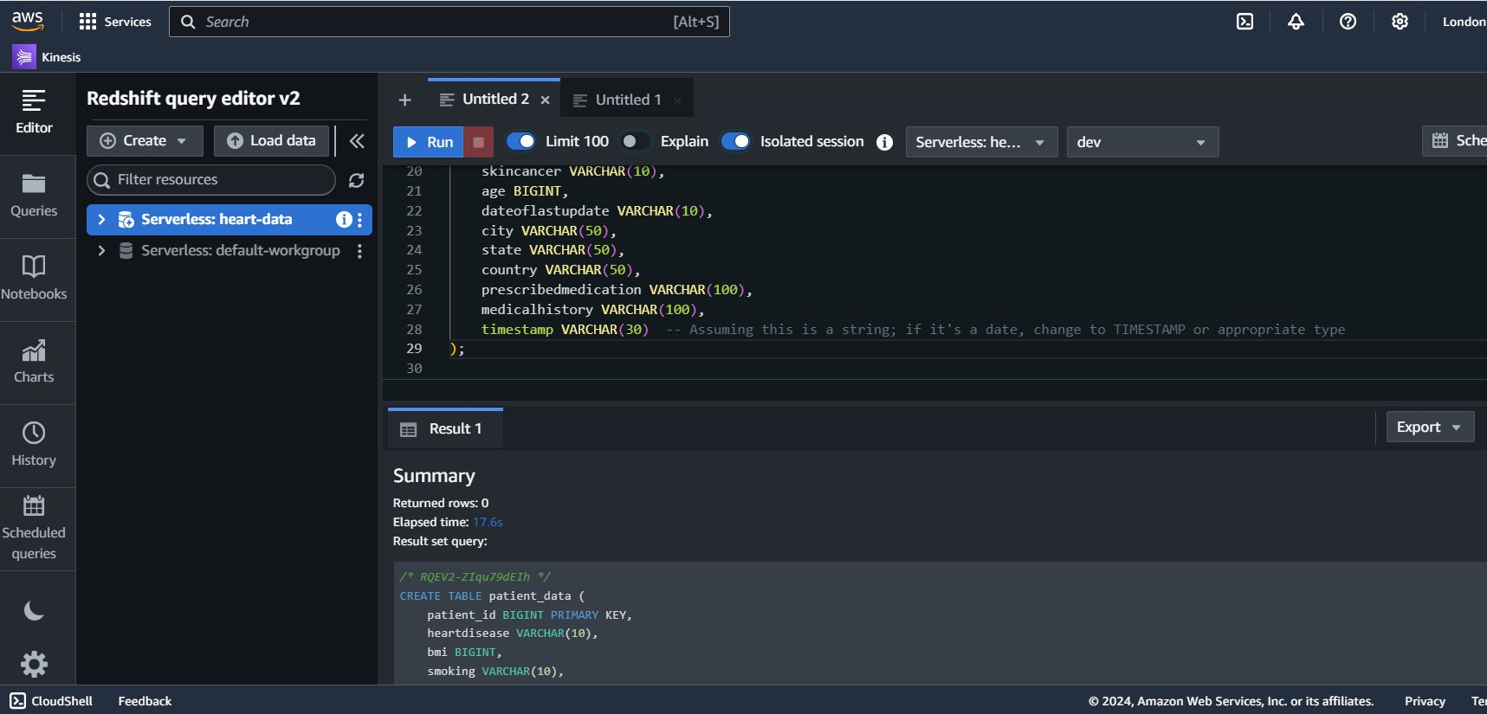
Creating and Loading Data into Managed Tables in Redshift
Managed Table Creation:
We created a table named patient_data in Amazon Redshift, defining various columns to match our health data. The table included fields for patient demographics, health conditions, lifestyle factors, and timestamps.

Slide 19
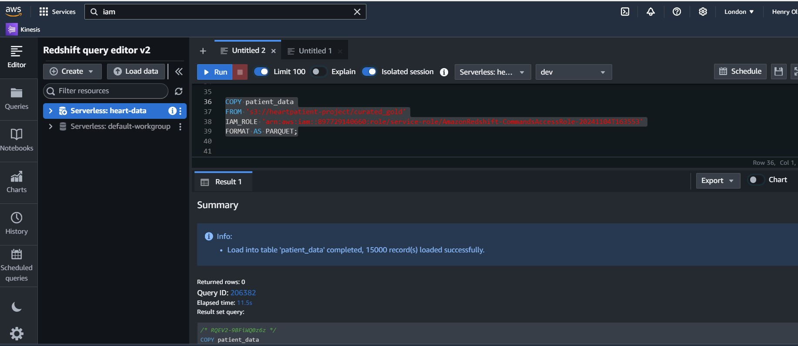
Data Loading:
We used the COPY command to load data from our S3 bucket, leveraging an IAM role for secure data access. Data was loaded in Parquet format to optimize performance and storage.

Slide 20
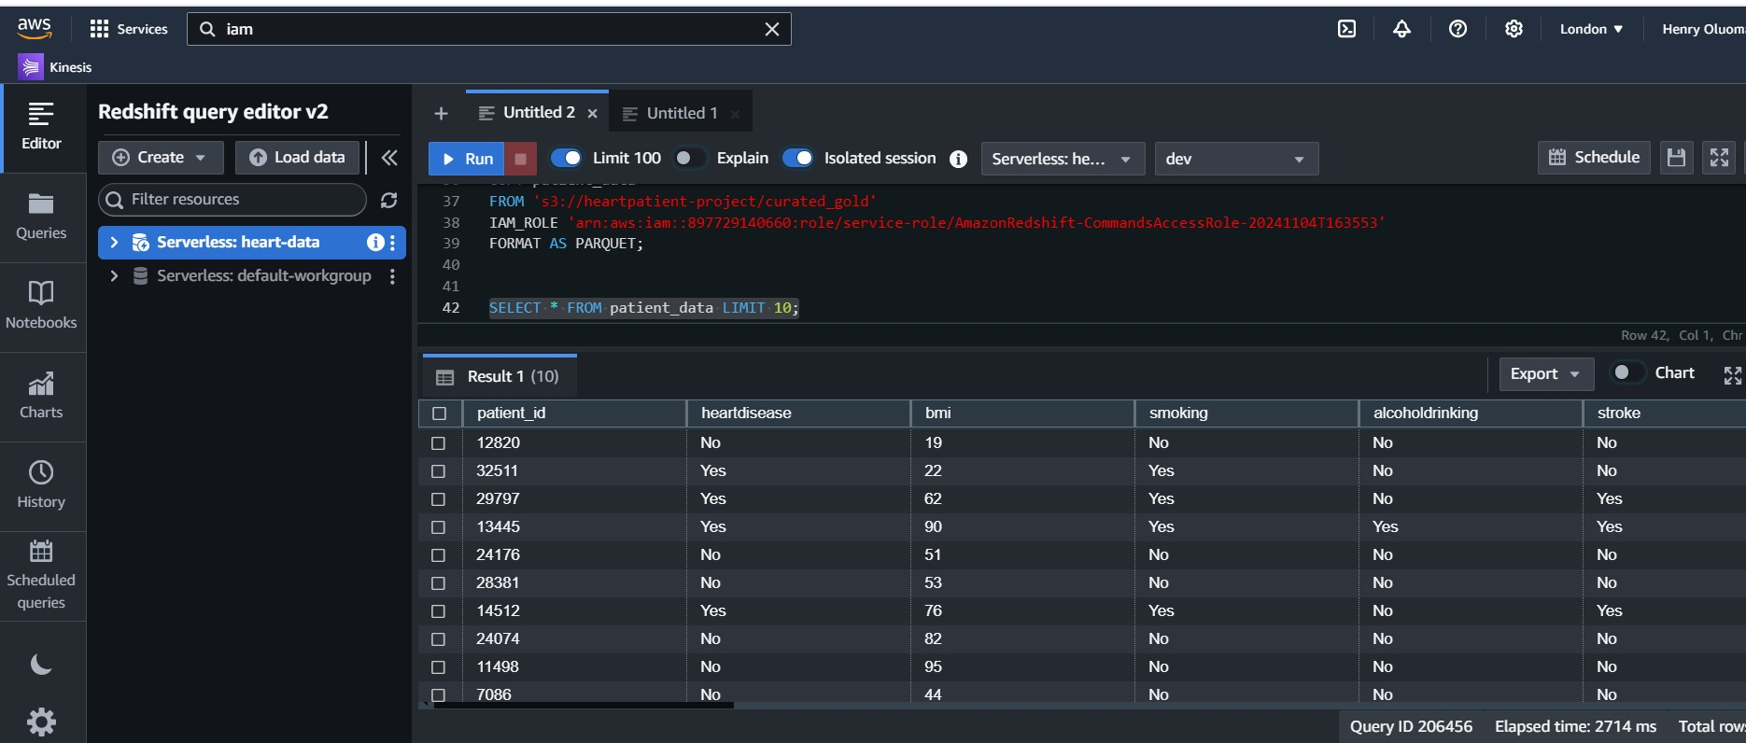
After loading, we validated the data by running SELECT queries to check a sample of records and ensure the structure was correct

Slide 21
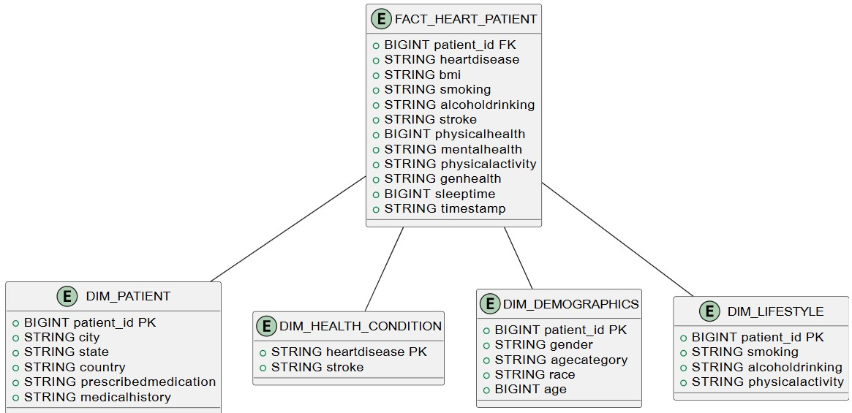

Slide 22
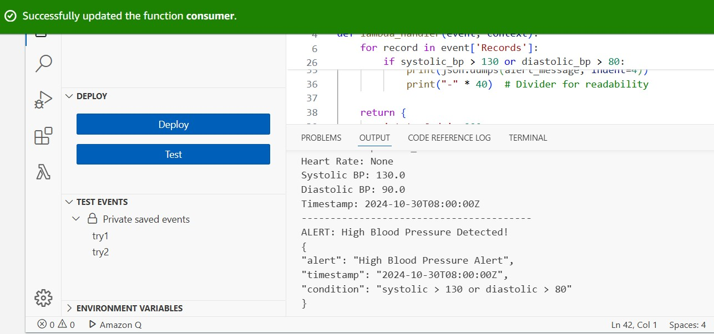
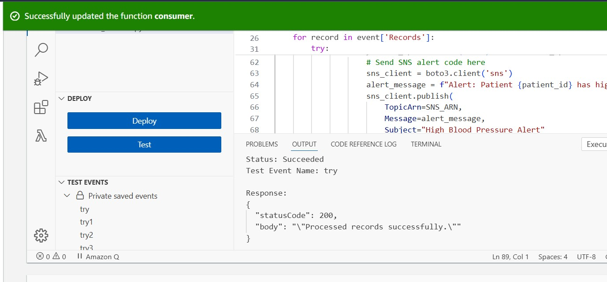
Real-Time Data Processing
Data Source: JSON data from wearable health devices (e.g., heart rate monitors).
Data Ingestion:
AWS Lambda: invoked by device requests to send json data to amazon kinesis data streams.

Slide 23
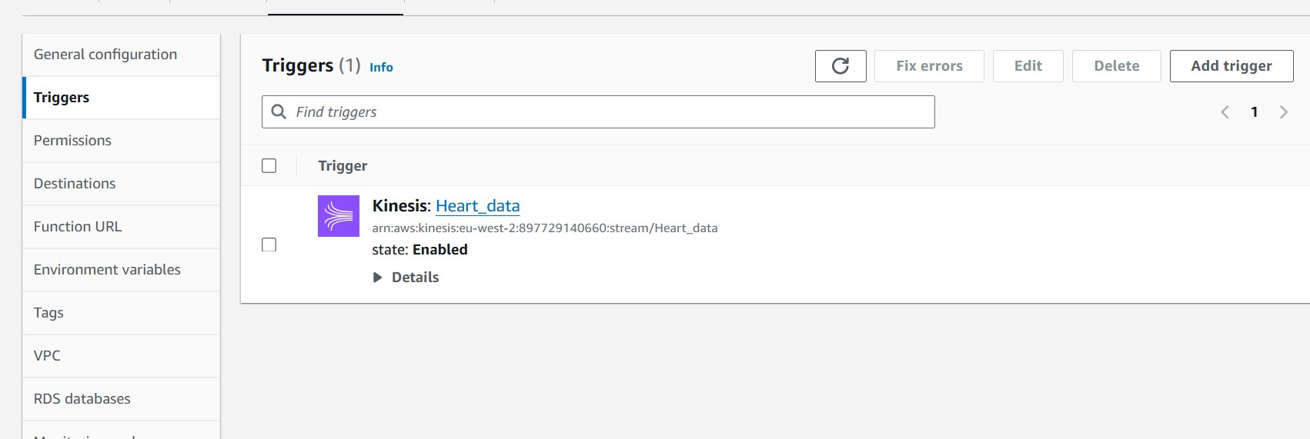
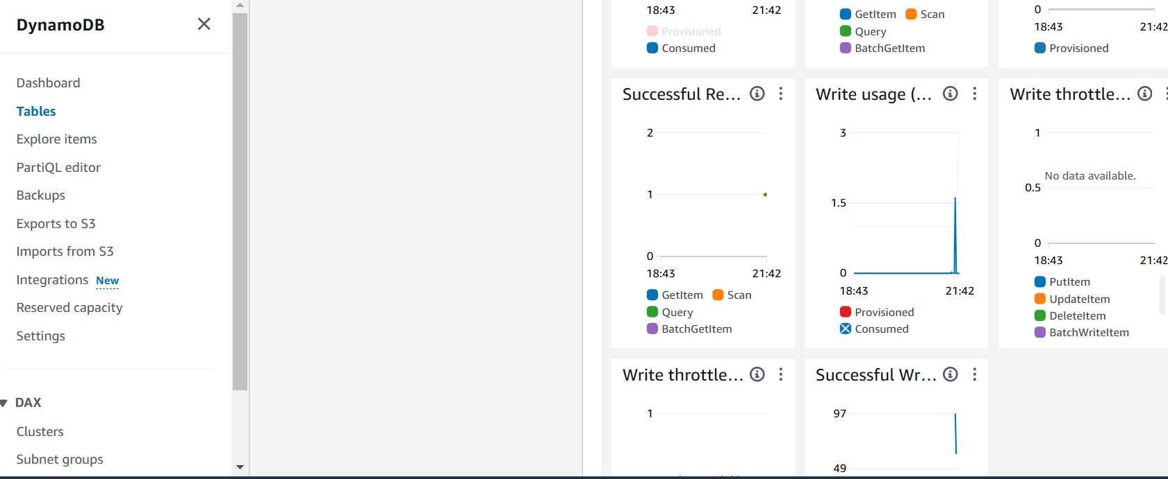
Data Streaming:
Amazon Kinesis Data Streams: Manages the ingestion of streaming data.
AWS Lambda (Processing): Transforms and analyses the data, checking for health thresholds (e.g., high heart rate or abnormal blood pressure) and stores the results in DynamoDB.

Slide 24
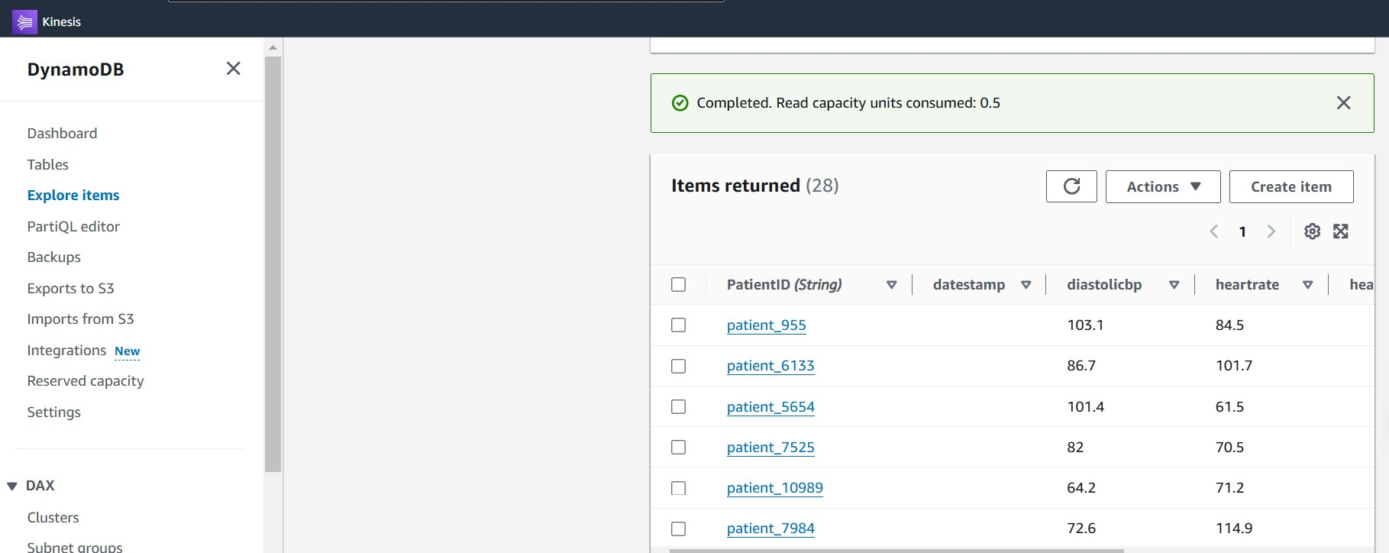
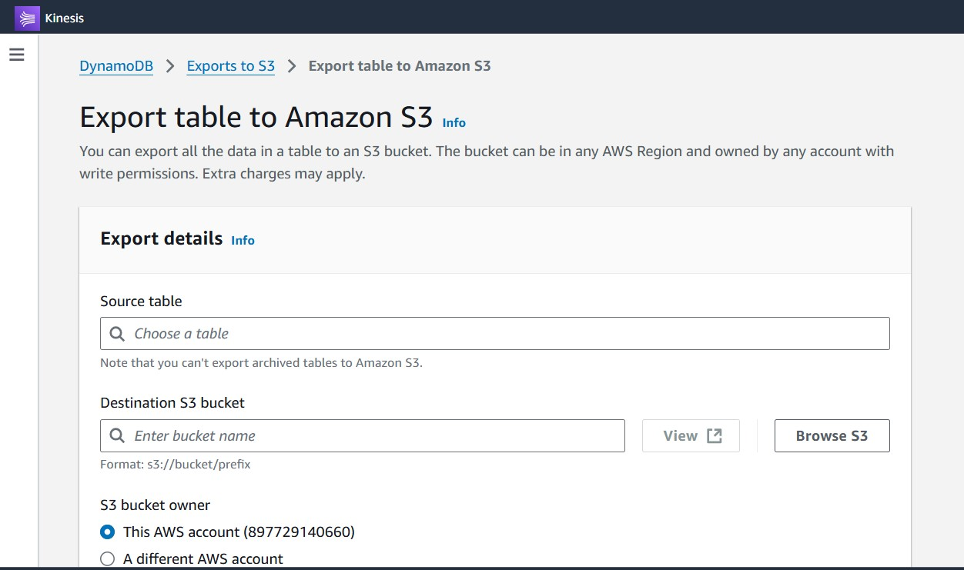
Alert Mechanism:
Amazon SNS: Sends alerts via email or SMS to stakeholders if a critical health reading is detected.
Amazon CloudWatch: Monitors performance metrics and generates alerts for system health

Slide 25
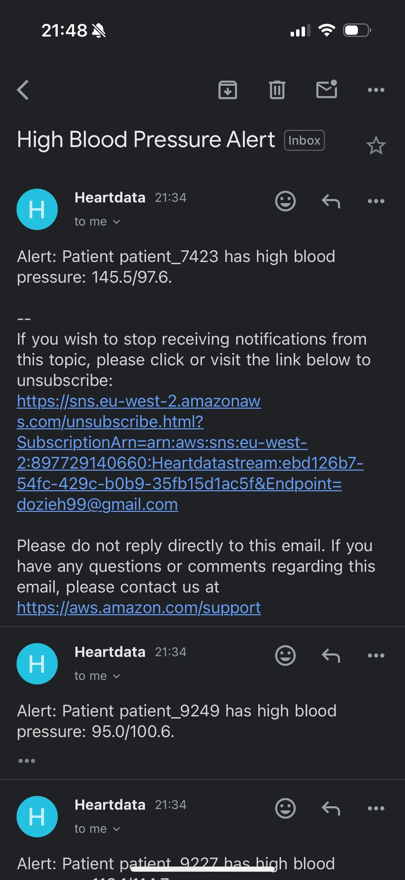
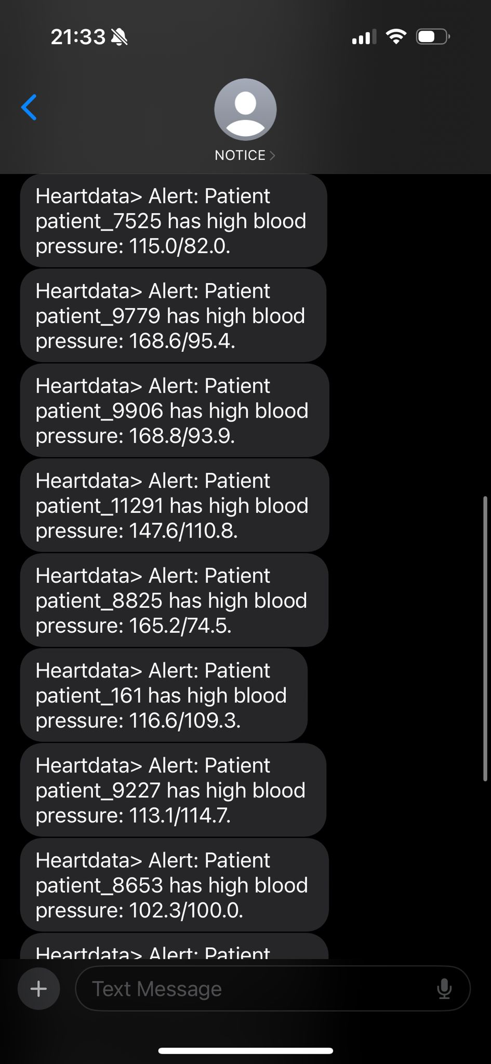
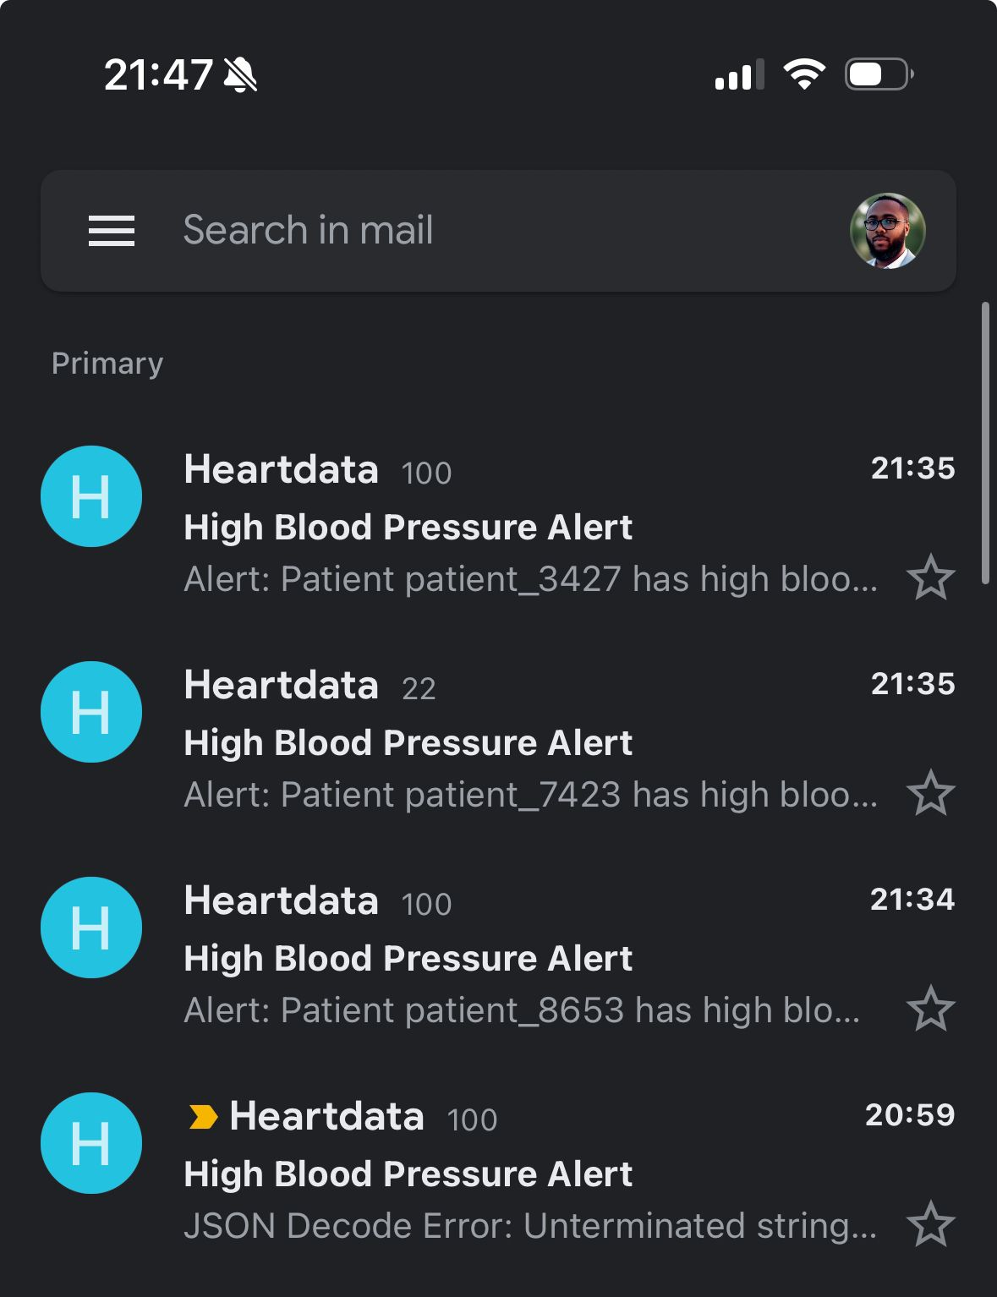

Slide 26
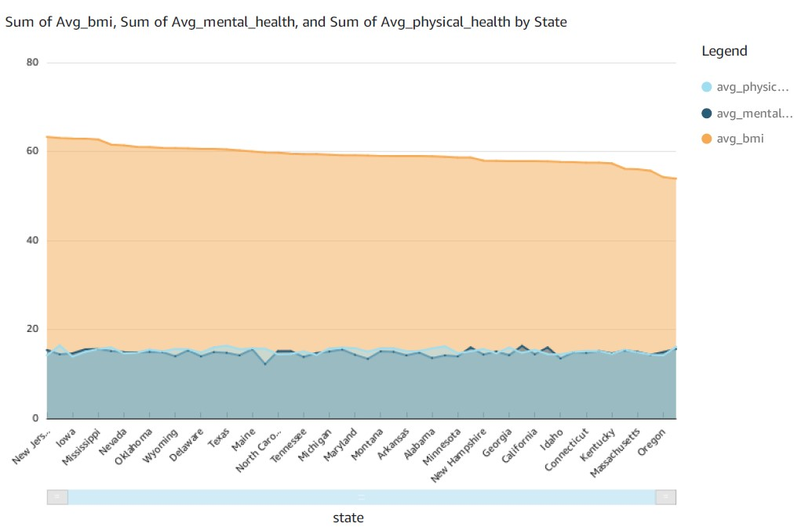
ANALYTICS/ VISUALISATIONS
What are the average BMI, average physical health scores, and average mental health scores of patients diagnosed with heart disease, segmented by state?

Slide 27
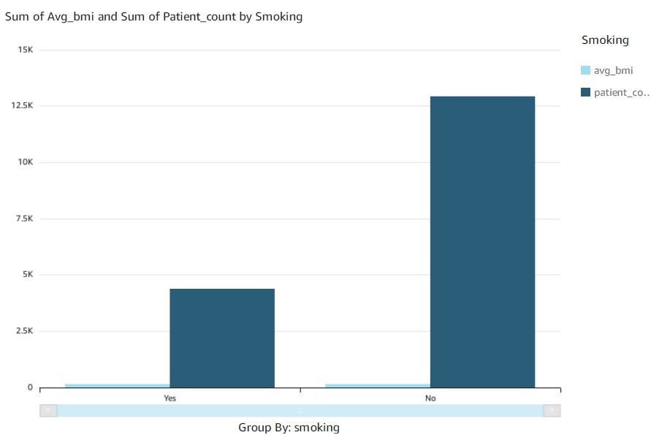
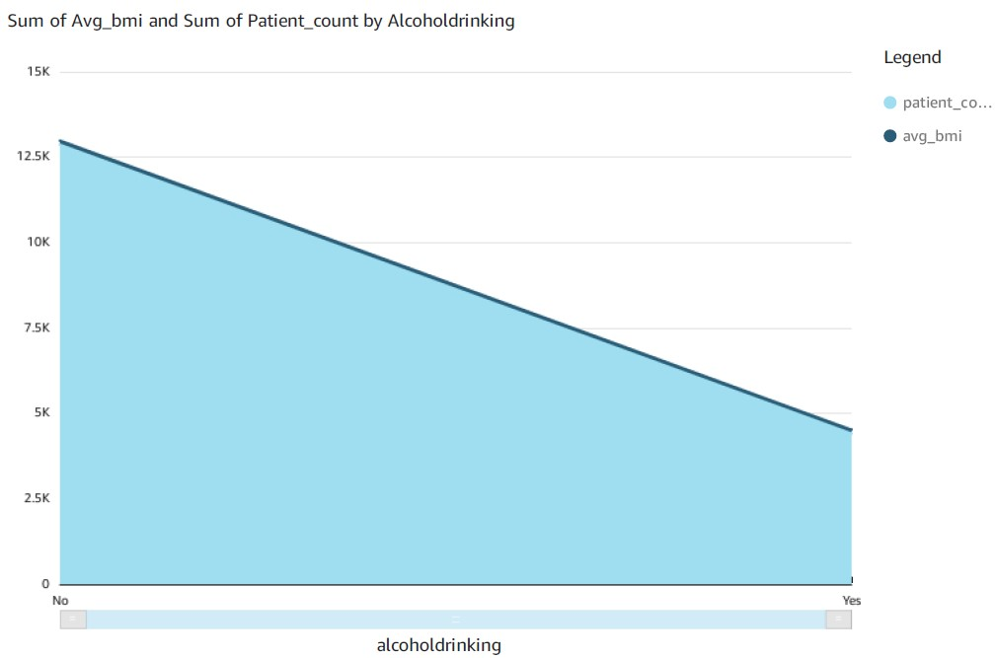
How do smoking and alcohol consumption habits relate to the patient count and average BMI of individuals diagnosed with heart disease?

Slide 28
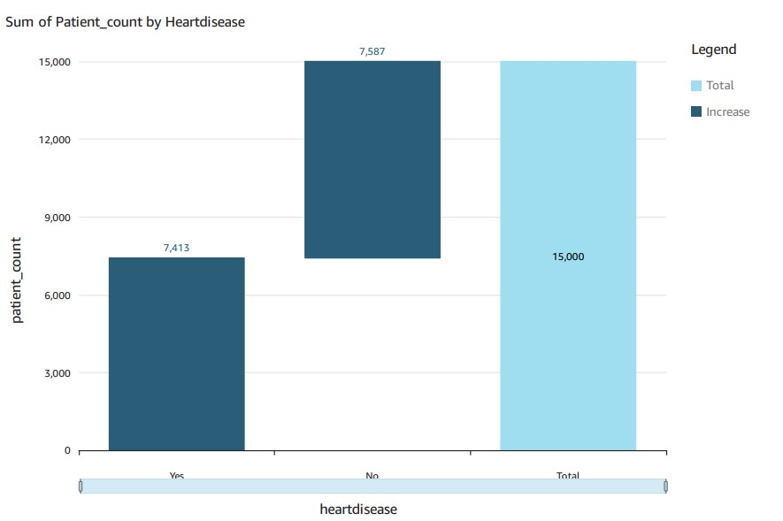
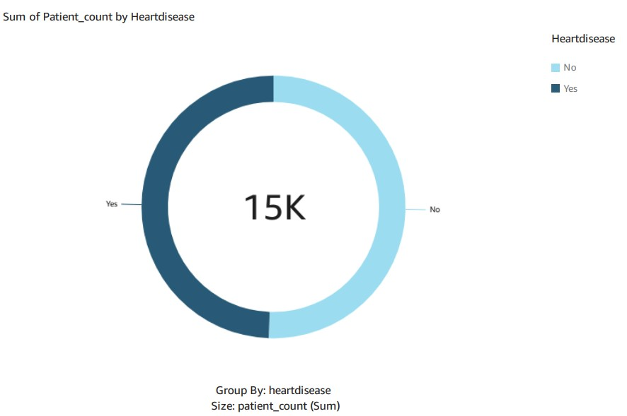
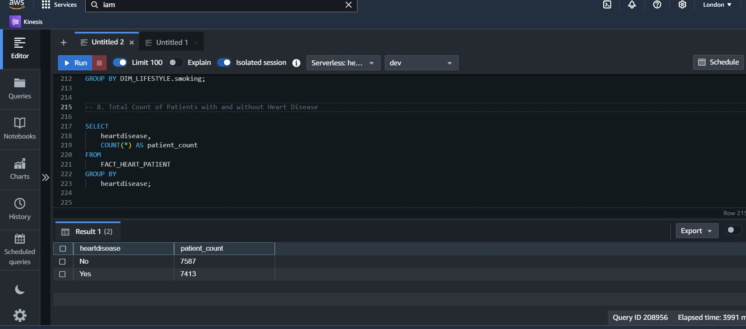
What is the Total Count of Patients with and without Heart Disease

Slide 29
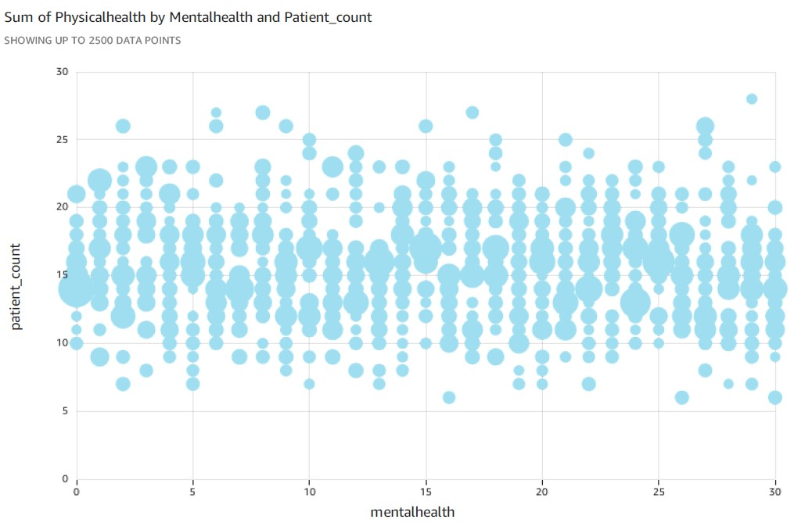
What is the distribution of patients based on their physical and mental health scores among individuals diagnosed with heart disease?

Slide 30
Conclusion and Future Recommendations
In conclusion, this project successfully leverages AWS cloud services to create a robust system for heart disease monitoring and analysis. By integrating both batch and real-time data, we can provide timely and accurate insights to healthcare professionals, ultimately improving patient outcomes.
Future Recommendations:
Moving forward, I recommend integrating machine learning models to predict heart disease risk proactively. Finally, as more data sources become available, we should scale the infrastructure to handle greater volumes of data efficiently.

Slide 31
THANKS
DO YOU HAVE ANY QUESTIONS?
Notes:
I’ve covered the key components of the system and how it improves heart disease monitoring. I’d love to hear your thoughts or answer any questions you may have.”

